Slide 1


CRIME VS TEMERTARURE
PRESENTED BY
Jamie DIAZ
PREETHI DAYANAND
JUAN TORRES

Slide 2


SUMMARY
This presentation was prepared for Rice Data Analytics Bootcamp Project 1 and will cover all tools and techniques learn during the first two months of class.
The main objective was to determine if there is a correlation between crime rate in Harris County vs Temperature during a 20-year span.
As an addition we included Median Household Income for Harris county to spice things up.
Now let’s dive in to the DATA!!!

Slide 3

Inspiration
Where did we get the idea?
“The relationship between temperature and crime has been discussed for decades. Fewer people are murdered in America during colder months than during warmer ones.”
Investigating the relationship between weather and violence in Baltimore, Maryland, USA
“When adjusting for temporal and meteorological factors, maximum daily temperature was positively associated with total trauma, intentional injury, and gunshot wounds presenting to Johns Hopkins Hospital along with total crime, violent crime, and homicides in Baltimore City. ”

Slide 4
HYPOTHESIS
Alternative Hypothesis - If a rise in ambient temperature is related to the # of incidents of violent crime in Harris County, then total yearly incidents of violent crime should be predictable by a line of format below with a slope that statistically significant (Linear Regression P_Value <.05) to the population.
Yearly incidents of Violent Crime = Slope (Average Yearly Temperature)+Intercept
or
Yearly incidents of Violent Crime = Slope (Maximum Yearly Temperature)+Intercept
Null Hypothesis - If a rise in ambient temperature is not related to the # of incidents of violent crime in Harris County, then itotal yearly ncidents of violent crime should be predictable by a line of format above with a slope that statistically insignificant (Linear Regression P_Value >.05) to the population.

Slide 5

DATA HUNT
API’s
FBI DATABASE - The Crime Data Explorer Base API URL is https://api.usa.gov/crime/fbi/sapi/
CENSUS DATABASE - API Call: https://api.census.gov/data/2017/acs/acs5/profile?get=group(DP02)&for=us:1
OPEN WEATHER DATABASE – http://frontierweather.com
CSV’s
INCOME.CVS
ORI.CSV
HOU_DAILY.CSV
COUNTY_ZIP_062019.XLSX - https://www.huduser.gov/portal/datasets/usps_crosswalk.html
MODULE WRAPPER
CensusData 1.3 – pip insall CensusData

Slide 6
DATA AND CLEANUP & EXPLORATION
Tool used in this process:
API’s
CSV’s
EXCEL
GOOGLEFU
JUPYTER NOTEBOOK
PYTHON – PANDAS - MATPLOTLIB
Questions that came up when gathering and compiling data:
Definition of violent crime: what subcategories does it include?
Example statistics on rape change with definition of rape in 2001
How do we account for missing data?
Delete
Use average of adjacent data points
3. Technical issues
API rate limits
One source for all data?

Slide 7

LET ME SEE THE CODE!!

Slide 8

DATA ANALYSIS
Steps used to analyze the data:
Find and clean datasets
Troubleshoot technical and conceptual questions with data
Compile data sets into one file for analysis
3. Visualize data
4. Run tests (Linear Regression)
5. Analysis, conclusions, and implications

Slide 9
LET ME SEE THE CODE!!

Slide 10
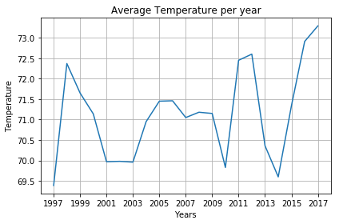
AVERAGE TEPERATURE PER YEAR
Graph: Time Series
Description: This plot represents the average tempreture per year over a 20-year spam.
X-Axis: Years
Y-Axis: Average Temperature

Slide 11
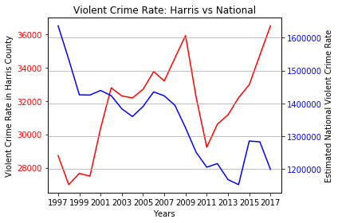
VIOLENT CRIME RATE: HARRIS VS NATIONAL
Graph: Two Time plot on different scale Y-axis
Description: This plot represents the Violent Crime Rate in Harris County. per year and Estimated National Violent Crime Rate over a 20-year spam.
X-Axis: Years
Y1-Axis: Violent Crime Rate in Harris County.
Y2-Axis: Estimated National Violent Crime Rate.

Slide 12
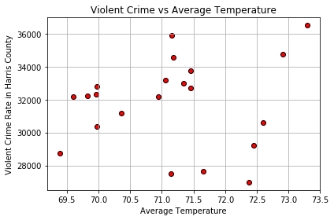
VIOLENT CRIME VS AVERAGE TEMPERATURE
Graph: Scatter Plot
Description: This plot represents the Violent Crime Rate in Harris County and Estimated National Violent Crime Rate over Average Temperature.
X-Axis: Average Temperature
Y1-Axis: Violent Crime Rate in Harris County.

Slide 13
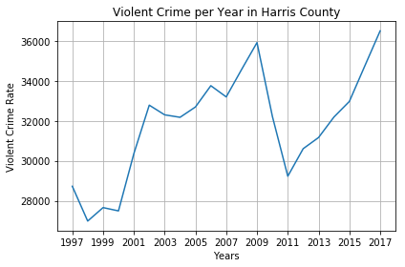
VIOLENT CRIME PER YEAR IN HARRIS COUNTY
Graph: Time Series
Description: This plot represents the Violent Crime over a 20-year spam.
X-Axis: Years
Y1-Axis: Violent Crime

Slide 14
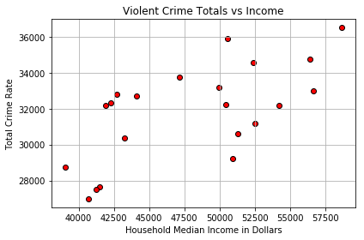
VIOLENT CRIME TOTALS VS INCOME
Graph: Scatter Plot
Description: This plot represents the Total Crime Rate over Household Median Income in Dollars.
X-Axis: Household Median Income in Dollars.
Y1-Axis: Total Crime Rate

Slide 15
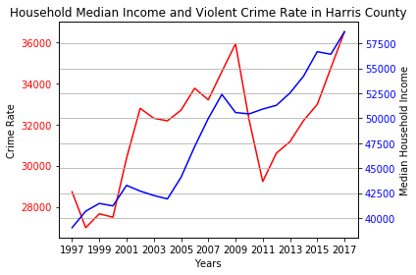
HOUSEHOLD MEDIAN INCOME AND VIOLENT CRIME RATE IN HARRIS COUNTY
Graph: Two Time plot on different scale Y-axis
Description: This plot represents the Crime Rate and Median Household Income over a 20-year spam.
X-Axis: Years
Y1-Axis: Crime Rate.
Y2-Axis: Median Household Income

Slide 16
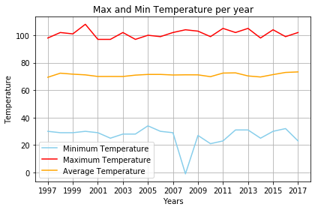
MAX AND MIN TEMPERATURE PER YEAR
Graph: Three Time plot on same Y-axis
Description: This plot represents the Maximum, Minimum, and Average Temperature over a 20-year spam.
X-Axis: Years
Y-Axis: Maximum Temperature
Y-Axis: Minimum Temperature
Y-Axis: Average Temperature

Slide 17
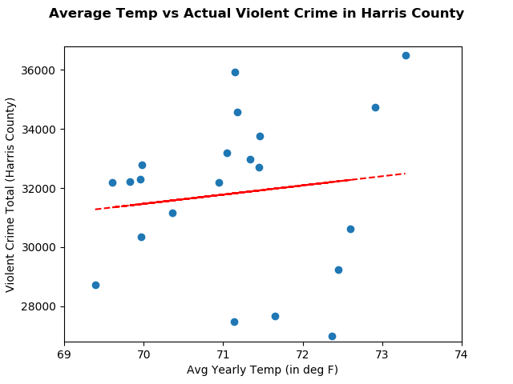
QUESTION 1
Is there a statistically significant linear correlation between yearly incidents of violent crime in Harris County and the average yearly temperature in Harris County between 1997 and 2017?

Slide 18
ANSWER 1
Is there a statistically significant linear correlation between yearly incidents of violent crime in Harris County and the average yearly temperature in Harris County between 1997 and 2017?
Results of Linear Regression :
yearly incidents of violent crime = 310.61(avg yearly temp)+ 9723.62
P_value for slope = .5719471570250014 with Standard Error of 540.0656038008858
Is this linear relationship statistically significant? .57>.05, so it is not statistically significant.

Slide 19
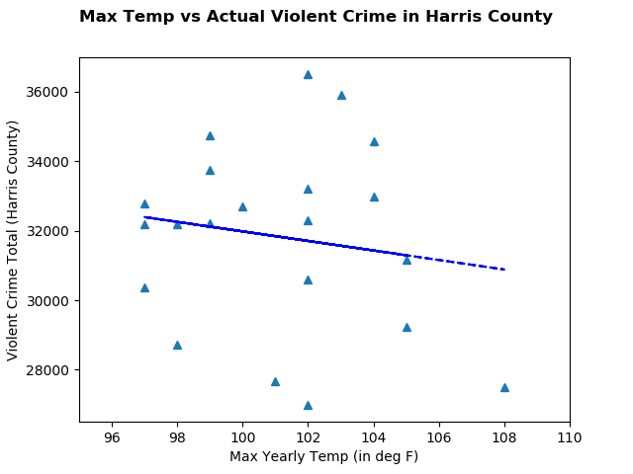
QUESTION 2
Is there a statistically significant linear correlation between yearly incidents of violent crime in Harris County and the maximum yearly temperature in Harris County between 1997 and 2017?

Slide 20
ANSWER 2
Is there a statistically significant linear correlation between yearly incidents of violent crime in Harris County and the maximum yearly temperature in Harris County between 1997 and 2017?
Results of Linear Regression :
yearly incidents of violent crime = -137.038(maximum yearly temp)+ 45683.02
P_value for slope = . 49942653120593294 with Standard Error of 199.02304128816306
Is this linear relationship statistically significant? .499>.05, so it is not statistically significant.

Slide 21
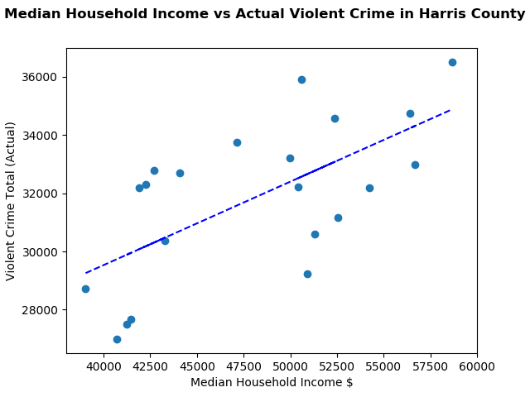
QUESTION 3
Is there a statistically significant linear correlation between median yearly household income in Harris County and yearly incidents of violent crime in Harris County between 1997 and 2017?

Slide 22
ANSWER 3
Is there a statistically significant linear correlation between median yearly household income in Harris County and yearly incidents of violent crime in Harris County between 1997 and 2017?
Results of Linear Regression :
Yearly incidents of violent crime=.028657(median household income)+18068.087
P_value for slope = 0.001534408847509015 with Standard Error of 0.07753959103453054
Is this linear relationship statistically significant? .0015< .05, so it is statistically significant.

Slide 23
Analysis – Linear Regression Results
Results for | Slope | Intercept | R_value | P Value | Standard Error | Line | Significant?
Avg Yr Temp vs Yr Violent Crime | 310.611856 | 9723.62086 | 0.13081176 | 0.57194716 | 540.0656038 | yearly incidents of violent crime = 310.61(avg yearly temp)+ 9723.62 | No
Max Yr Temp vs Yr Violent Crime | -137.0379 | 45683.024 | -0.1560302 | 0.49942653 | 199.0230413 | yearly incidents of violent crime = -137.038(max yearly temp)+45683.02 | No
Median Household Income vs Yr Violent Crime | 0.28656981 | 18068.0868 | 0.64670549 | 0.00153441 | 0.077539591 | yearly incidents of violent crime =.028657(median household income)+18068.087 | Yes!

Slide 24
Analysis
We did not find a statistically significant linear relationship between average yearly temp and total yearly incidents of violent crime or between maximum yearly temp and total yearly incidents of violent crime in Harris County. This was in keeping with an observation from the article that provided the inspiration for this investigation indicated below:
“In Southern cities like Atlanta and New Orleans, the effect exists but is weaker.”
We did find a statistically significant relationship between total yearly incidents of violent crime and median yearly household income in Harris County which warrants much more investigation. Why does a general rise in economic means across the county seem to lead to MORE violent crime? For Harris County median yearly household income looks to be a better potential predictor of violent crime that temperature.
Crime itself is a phenomenon of human behavior influenced by multiple factors including sociological, economic, environmental, and psychological factors to name a few. These are beyond the scope of this particular project but make for interesting future investigations.

Slide 25
Q&A
PRESENTED BY
JAMiE DIAZ
PREETHI DAYANAND
JUAN TORRES

